Slide 1
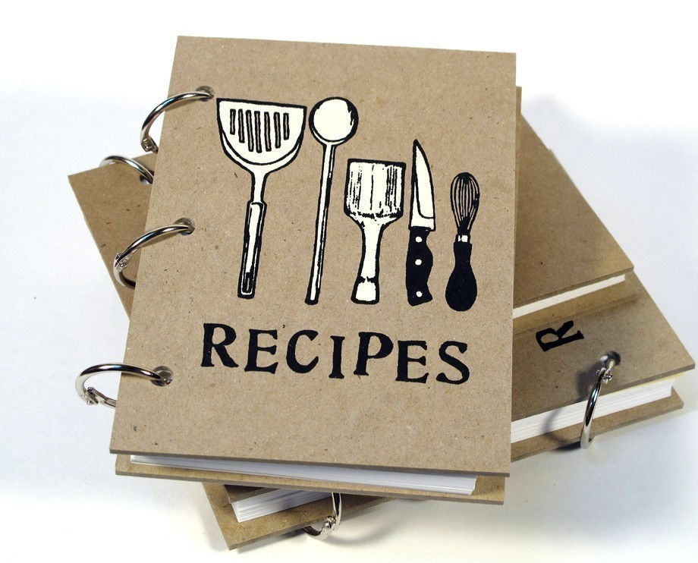
Recipe-book

Slide 2
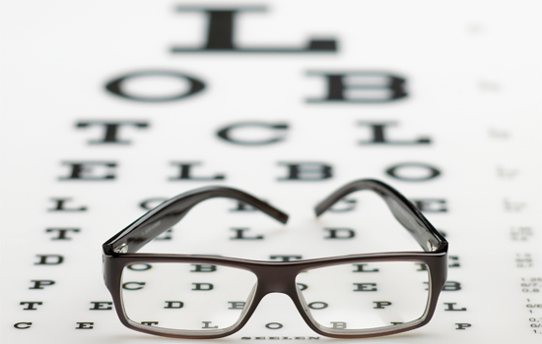
Why?
Many elderly people have problem with remembering things because of their age or diseases (e.g. sclerosis). Particularly they can have problem with remembering complex food recipies, which often contain many ingredients or are difficult to prepare. What is more there eyesight is also not perfect anymore. Therefore they may have a problem reading recipe books or recipies from the internet.

Slide 3
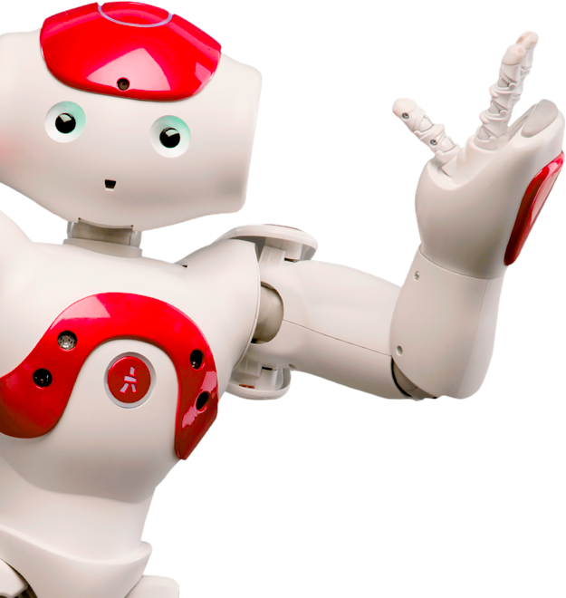
What to do?
Our rapp application is ment to be a big help in such situations. It contain food recipies along with needed ingredients. The recipies are chosen by talking to a robot (in our case nao). The robot guides its user through the whole proccess of preparing the dish: gathering ingredients and cooking. At the end he greets the user politely with a friendly gesture.

Slide 4
Short film presentation

